Slide 1
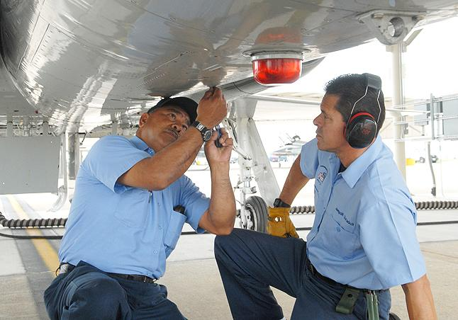
“Beyond HR Transformation: Seize New Opportunities Through Value Added HR”
Asma Bajawa
Managing Director, PeopleFirst
4th August 2010
Notes:
WELCOME
WHO AM I?

Slide 2
Role of an Effective HR Function
Develop and
deliver HR
strategy in
line with
Corporate
Objectives
Manage
Employee
Lifecycle
Develop
Employer
Brand
Strategic Alignment and Customer Focus
Notes:
SO WHAT IS CULTURE ?
PLAYS AN IMPORTANT PART IN CHANGE
HOW WOULD YOU DESCRIBE YOUR CULTURE?
DO YOU THINK THE AVIATION INDUSTRY HAS A DIFFERENT CULTURE TO OTHER INDUSTRY SECTORS?
COULD WE INTRO QUESTIONNAIRE?
CONTEXT FOR THE TALK IS ORGANISATIONAL CULTURE

Slide 3
What is Value Added HR?
Value added refers directly to a product or service that increases the worth or benefit to customers
Who are our customers?
  Employees
  Managers
  Customers
  Shareholders
It is important to understand what is that your customer values
To appreciate the added value of HR we need a ‘measure of the impact’ on each of our customers
Notes:
SO WHAT IS CULTURE ?
PLAYS AN IMPORTANT PART IN CHANGE
HOW WOULD YOU DESCRIBE YOUR CULTURE?
DO YOU THINK THE AVIATION INDUSTRY HAS A DIFFERENT CULTURE TO OTHER INDUSTRY SECTORS?
COULD WE INTRO QUESTIONNAIRE?
CONTEXT FOR THE TALK IS ORGANISATIONAL CULTURE

Slide 4
Measuring Value
In order to measure how much value HR adds to a business we need to refocus on what it is we measure
Internal operational measures traditionally track activity cost and quality but as HR transforms to be more business oriented traditional measures may no longer apply
Measures should be realigned so that they are business driven not HR driven
Quantify impact on business performance
Innovative measures that demonstrate the value add of HR by driving business performance
HR measures need to be realigned to activities and behaviours of HR professionals and line managers if HR practices are to impact the bottom line
Customer Measures
  Employee satisfaction
  HR practices
  Customer satisfaction
  Market Value
Notes:
SO WHAT IS CULTURE ?
PLAYS AN IMPORTANT PART IN CHANGE
HOW WOULD YOU DESCRIBE YOUR CULTURE?
DO YOU THINK THE AVIATION INDUSTRY HAS A DIFFERENT CULTURE TO OTHER INDUSTRY SECTORS?
COULD WE INTRO QUESTIONNAIRE?
CONTEXT FOR THE TALK IS ORGANISATIONAL CULTURE

Slide 5
Measuring Value
“What you measure is what you get’’
Kaplan & Norton 1992
Notes:
SO WHAT IS CULTURE ?
PLAYS AN IMPORTANT PART IN CHANGE
HOW WOULD YOU DESCRIBE YOUR CULTURE?
DO YOU THINK THE AVIATION INDUSTRY HAS A DIFFERENT CULTURE TO OTHER INDUSTRY SECTORS?
COULD WE INTRO QUESTIONNAIRE?
CONTEXT FOR THE TALK IS ORGANISATIONAL CULTURE

Slide 6



Business Drivers for Value Added HR
New ownership, shift from government to a market driven focus. Strategy to increase market share through global acquisitions and growth of organisational capability
Start up, new entrant to market, Strong focus on customer and brand development through Innovative, and creative products and services attracting top talent
Shareholder driven change to implement best practices across core HR practices to increase market value and return on investment in readiness for sale
Privatisation of the Department of Civil Aviation Abu Dhabi with the strategic objective of establishing a world class airports management company.
Notes:
SO WHAT IS CULTURE ?
PLAYS AN IMPORTANT PART IN CHANGE
HOW WOULD YOU DESCRIBE YOUR CULTURE?
DO YOU THINK THE AVIATION INDUSTRY HAS A DIFFERENT CULTURE TO OTHER INDUSTRY SECTORS?
COULD WE INTRO QUESTIONNAIRE?
CONTEXT FOR THE TALK IS ORGANISATIONAL CULTURE

Slide 7
HR Role in Seizing Opportunities for Competitive Advantage
Workforce Planning
Grow and develop
Separation
Attract and Hire
Manage and Maintain
Focus on entire HR system rather then individual HR practices
Notes:
SO WHAT IS CULTURE ?
PLAYS AN IMPORTANT PART IN CHANGE
HOW WOULD YOU DESCRIBE YOUR CULTURE?
DO YOU THINK THE AVIATION INDUSTRY HAS A DIFFERENT CULTURE TO OTHER INDUSTRY SECTORS?
COULD WE INTRO QUESTIONNAIRE?
CONTEXT FOR THE TALK IS ORGANISATIONAL CULTURE

Slide 8
Considerations
Understand your business
Know your customer
Role of HR – is HR a support function to the business or a critical part of the business
Customer perception - How do you customers see HR?
Understand what your customers ‘value’
Realign HR measures to drive business performance rather than HR performance
Best fit versus best practice
HR competence

Slide 9
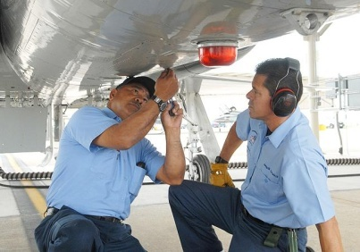
Thank You
Notes:
HR HAS IMPORTANT ROLE TO PLAY

